Slide 1
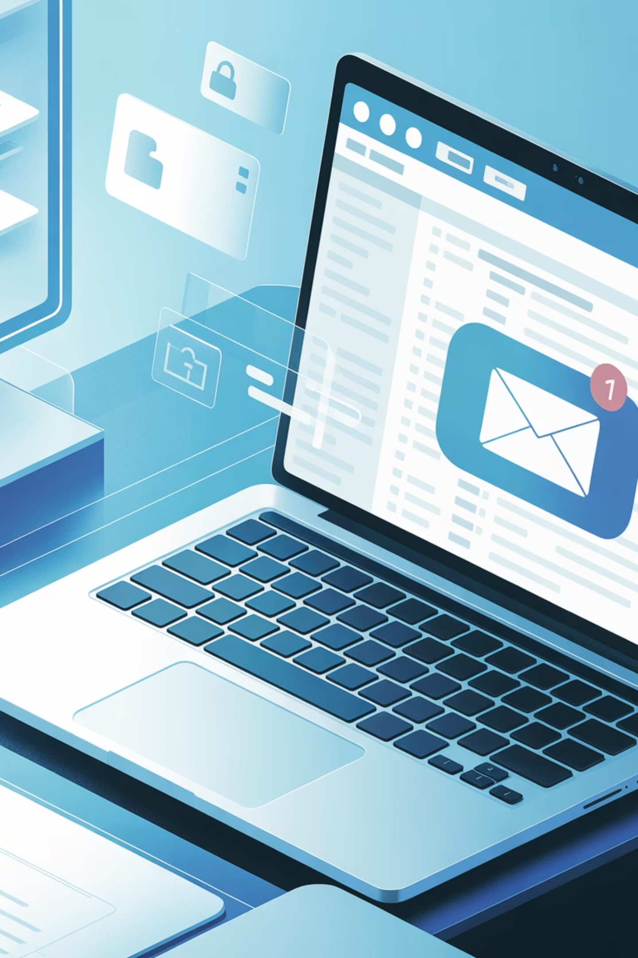
Phishing Awareness Training: Protecting Yourself and Your Organisation
Practical guidance and concise steps to recognise, report and stop phishing attacks — for every employee, on every device.

Slide 2
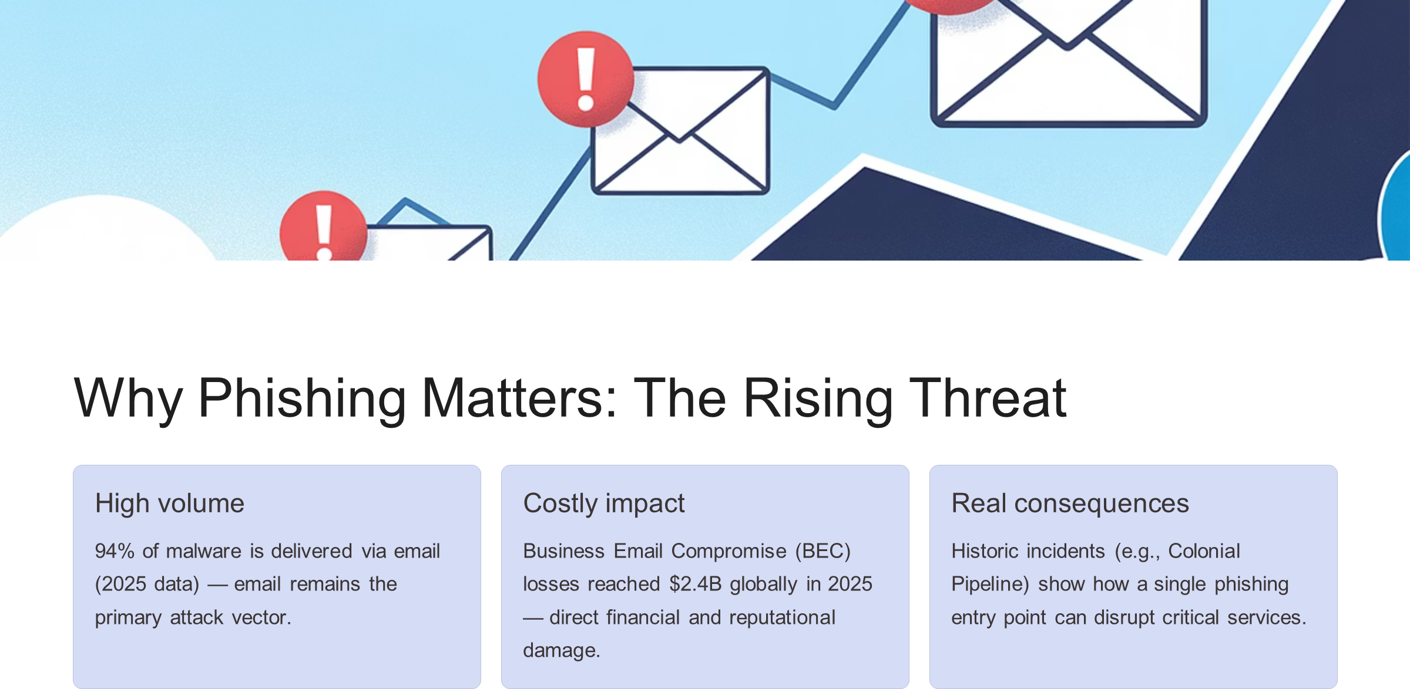

Slide 3
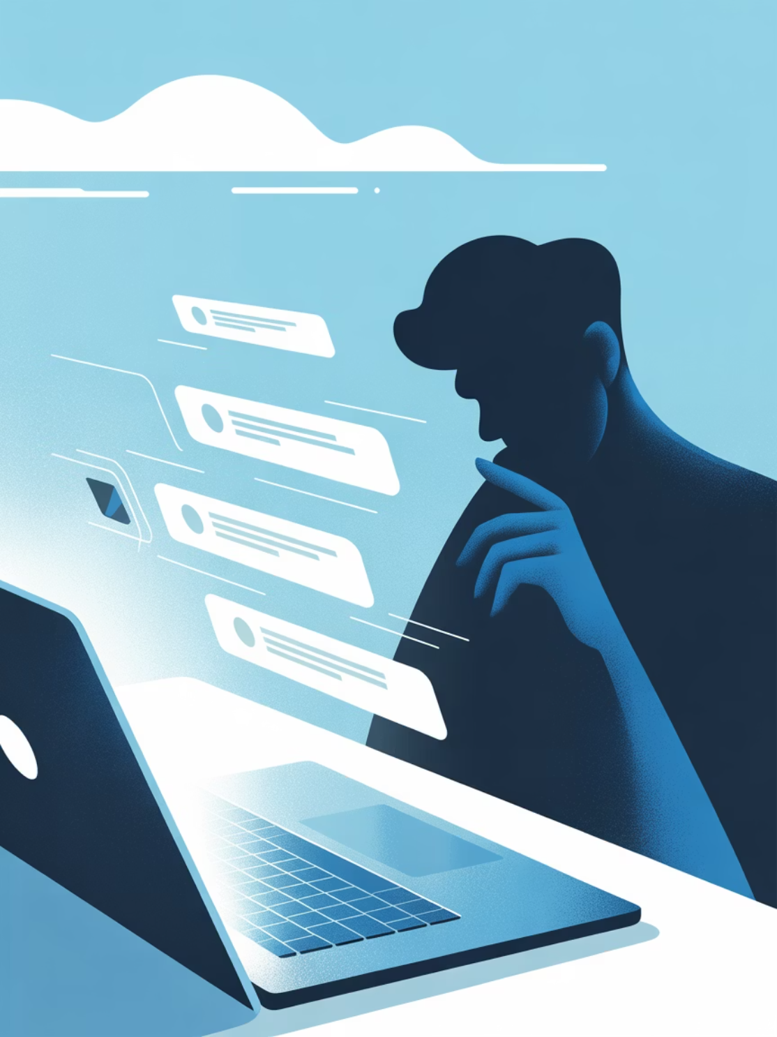
What is Phishing?
Phishing is social engineering where fraudsters impersonate trusted sources to trick people into revealing credentials, financial details or installing malware. It appears via email, SMS (smishing), phone calls (vishing) and counterfeit websites that mimic legitimate services.
Targets: passwords, card details, personal and corporate data
Channels: email, SMS, voice calls, fake login pages

Slide 4
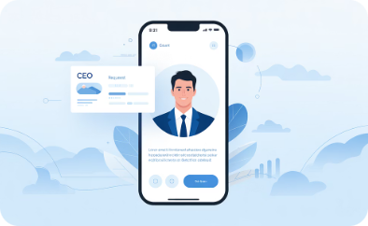
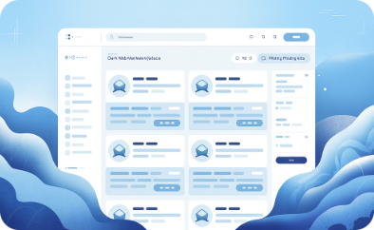
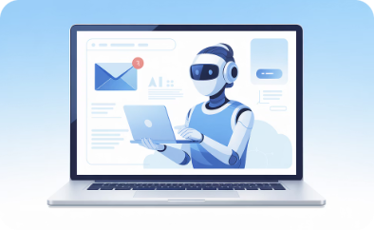
Modern Phishing Techniques: Beyond the Classic Email
BEC (Business Email Compromise)
Phishing-as-a-Service
AI-crafted messages
Attackers impersonate executives to request urgent transfers or confidential data — high success when combined with authority pressure.
Pre-built kits on underground markets make attacks accessible to novice criminals, increasing frequency and variety.
AI can generate highly convincing, grammatically flawless emails tailored to targets — making detection harder.

Slide 5
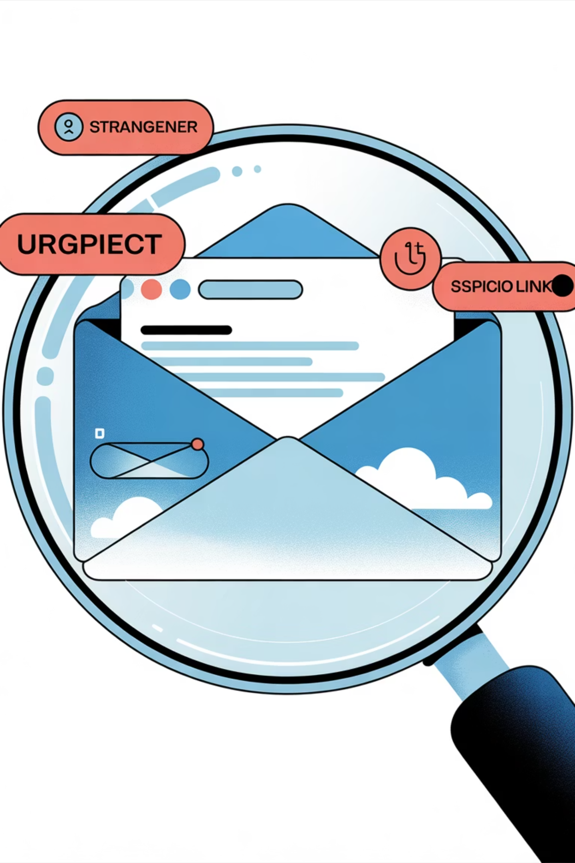
Spotting a Phishing Attempt: Key Red Flags
Urgency & pressure
Suspicious sender
Formatting errors
Look for language demanding immediate action or threatening consequences — a classic manipulation tactic.
Check the full sender address (not just the display name). Small domain changes or extra characters are giveaways.
Poor spelling, odd punctuation or inconsistent branding can signal a fraudulent message.
Verify links
Hover over links (desktop) to reveal the destination URL; on mobile, press-and-hold links to preview. Never assume a link matches its visible text.

Slide 6
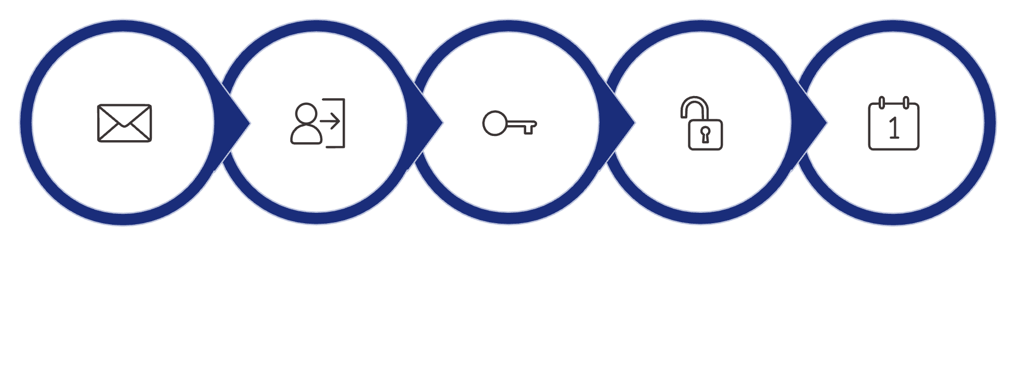

Real-World Example: Microsoft 365 Phishing Campaign
Attackers sent convincing login prompts to thousands of users, harvesting credentials and gaining unauthorised access. Consequences included data exposure and account misuse. The incident underscores the importance of multi-factor authentication (MFA) and rapid reporting.
Phishing Email
Fake Login
Credentials Stolen
Unauthorized Access
Data Exfiltration
Enable MFA and report suspicious login prompts immediately — this stops stolen credentials from granting access.

Slide 7

Protecting Yourself and Your Organisation
Think before you click
Pause on unexpected messages. Verify via a separate channel (phone call, official app) before acting on requests.
Verify & confirm
Contact the sender using known contact details rather than reply or using info in the suspicious message.
Use MFA & strong passwords
Enable multi-factor authentication everywhere and use a password manager for unique, complex credentials.
Report quickly
Report suspected phishing to IT/security immediately — rapid response limits damage and accelerates containment.

Slide 8
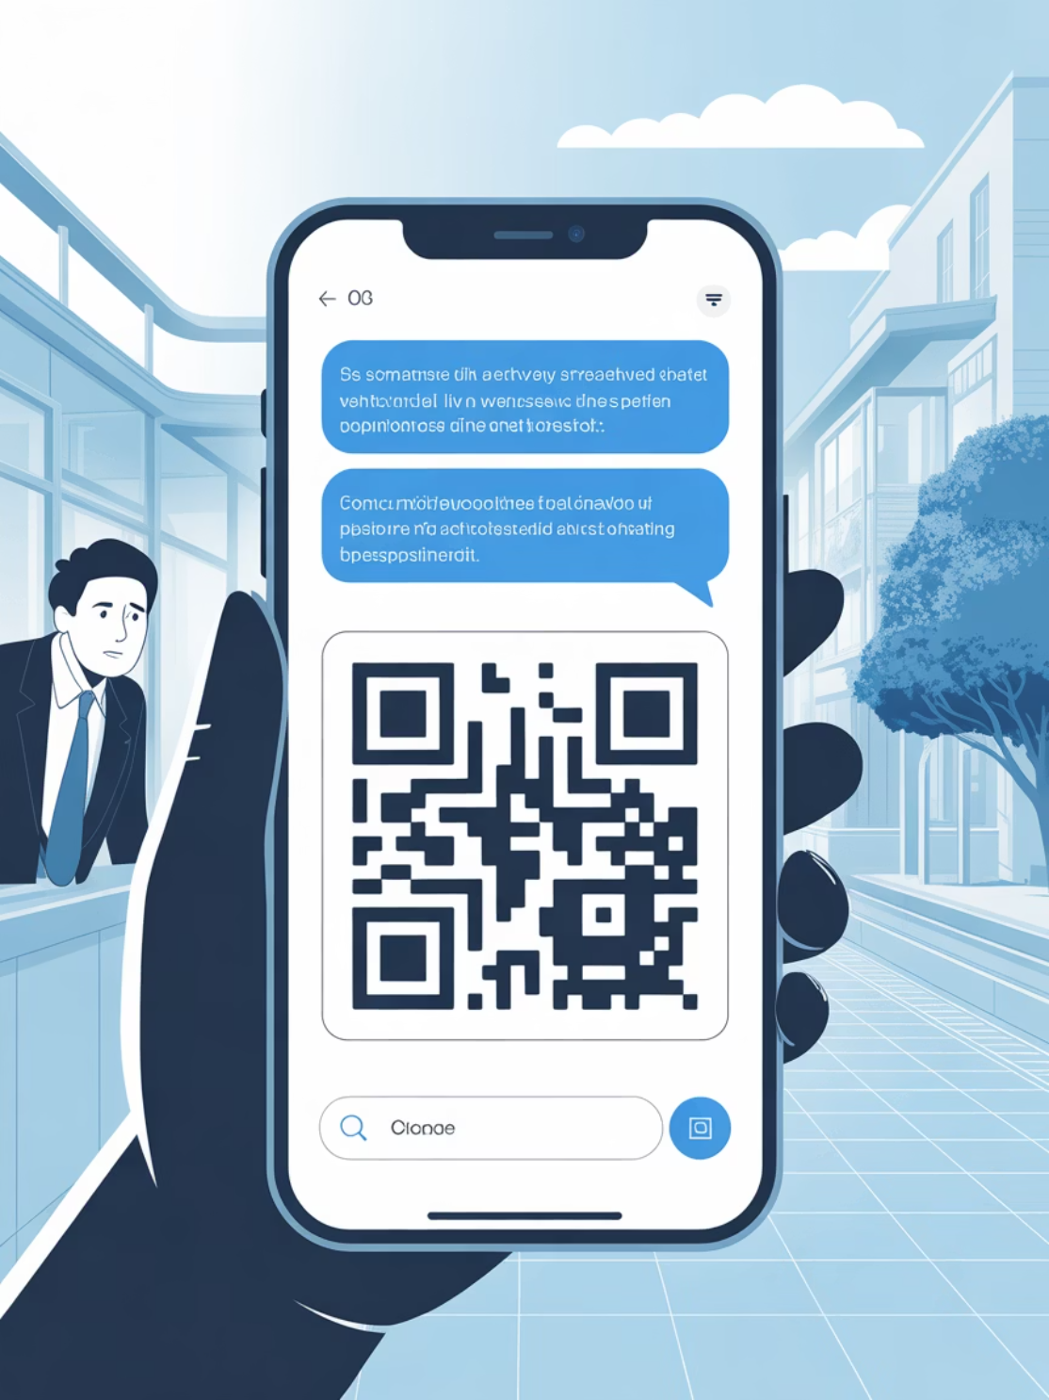
Phishing on Mobile Devices: Hidden Dangers
Small screens and truncated URLs make phishing harder to spot. SMS phishing (smishing), malicious QR codes (quishing) and deceptive app prompts are on the rise. Treat unexpected mobile messages with the same suspicion as email.
Preview links carefully — avoid tapping unknown QR codes
Check app store permissions and authenticity before installing
Use device security features (screen lock, app vetting)

Slide 9
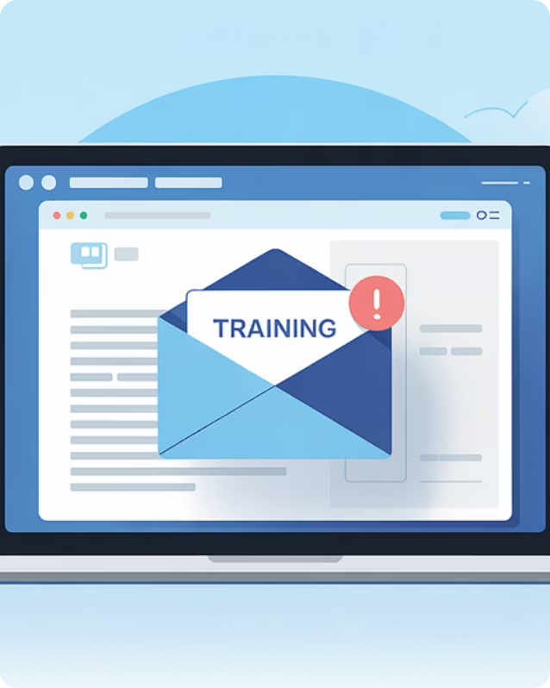
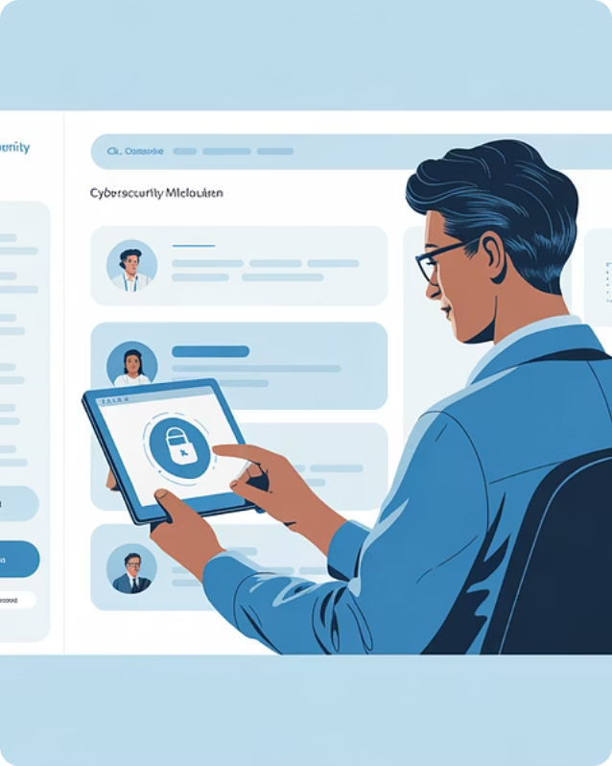
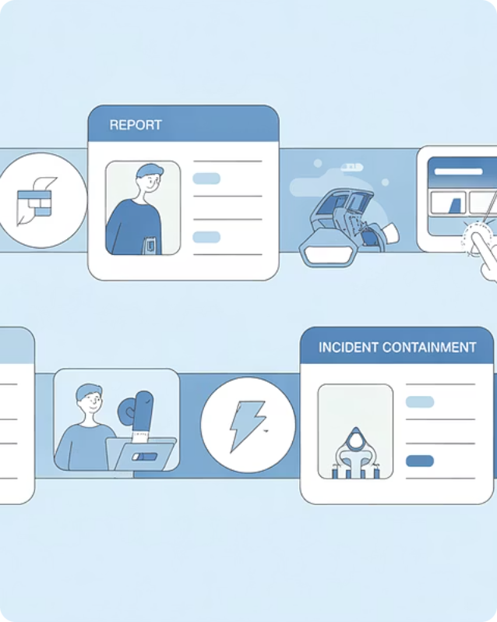
Training and Awareness: Your Best Defence
Simulated campaigns
Regular microtraining
Clear reporting
Short, frequent lessons keep skills fresh and awareness high — proven to reduce click rates substantially.
Simple, well-advertised reporting procedures empower employees act quickly and reduce exposure.
Realistic phishing simulations train staff to recognise threats and measure readiness.

Slide 10




Take Action Today:
Stay Vigilant, Stay Secure
Think before you click — pause and verify every unexpected message. Keep systems updated, enable MFA, and report suspicious activity. Build a culture where security is everyone’s responsibility. Together, we can stop phishing before it starts.
PROTECT
REPORT
RESPOND

